Slide 1
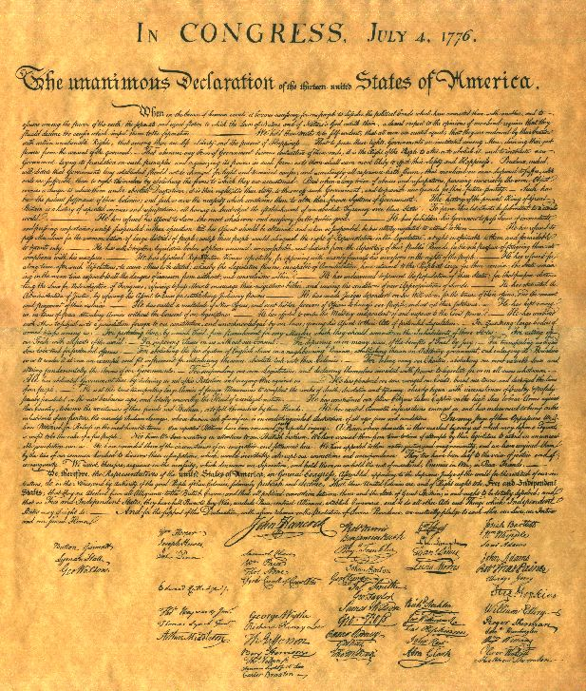
THE DECLARATION OF INDEPENDENCE
Bell Work:
Describe one cause of the American Revolution (Different from Monday & Tuesday)?
Describir una de las causas de la Revolución Americana?
Take out your Chromebook, pen or pencil and a piece of paper.
Standard 8.1.2: Analyze the philosophy of government expressed in the Declaration of Independence, with an emphasis on government as a means of securing individual rights (e.g., key phrases such as “all men are created equal, that they are endowed by their Creator with certain unalienable Rights”).
Notes:
1

Slide 2
THE DECLARATION OF INDEPENDENCE
Objective: Identify the author’s purpose in writing the Declaration of Independence and the words that support that purpose.
Notes:
2

Slide 3
THE DECLARATION OF INDEPENDENCE
Relevance:
It’s important for us to understand the purpose of the Declaration of Independence.
The goals and ideals found in the author’s words are the basis of our entire government today.
Notes:
3

Slide 4

Prior Knowledge
Have you ever been mad at a friend, family member or boyfriend/girlfriend?
Did you write a tweet, instagram, snapchat or facebook message telling everyone what they did to make you mad?
What kinds of things did you include in your post (not specifics, just in general)?

Slide 5
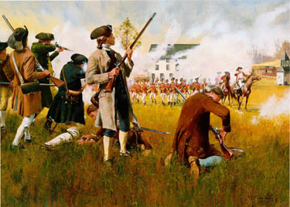
Concept - Background
When the first shots were fired between England and the Colonists at Lexington and Concord, it was the start of a revolution, the American Revolution.
After a year of fighting England, the colonists began to question the purpose of the American Revolution. The colonists no longer wanted to continue fighting just to remain under the authority of the oppressive English King. Instead they wanted to become a nation independent from England.
Notes:
5

Slide 6
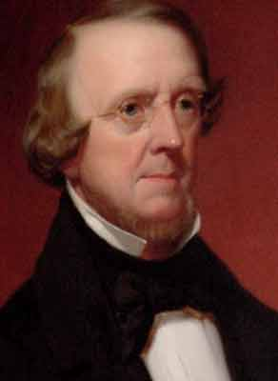
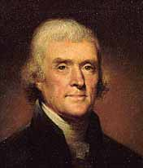
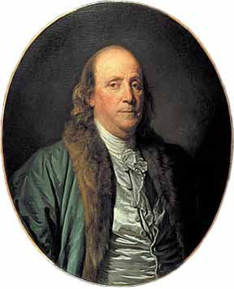
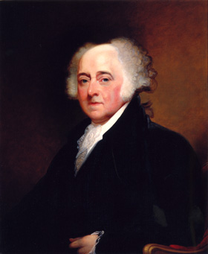
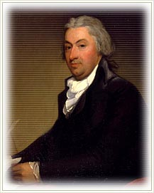
Concept - Purpose of the Declaration
In the summer of 1776, the Continental Congress asked a committee to write a formal document that would declare American independence. Committee members included:
Thomas Jefferson
  John Adams
  Benjamin Franklin
  Robert Livingston
  Roger Sherman
Thomas Jefferson, the youngest member, was asked to write the document and bring it back for the committee to edit. He did this in just 3 days.
Why did the colonists feel the need to write the Declaration of Independence?
Partner A tell Partner B “The colonists wanted to the write the declaration because ________”.
Partner B tell Partner A “I agree/disagree the colonists wanted the write the declaration because ____”.
Notes:
6

Slide 7
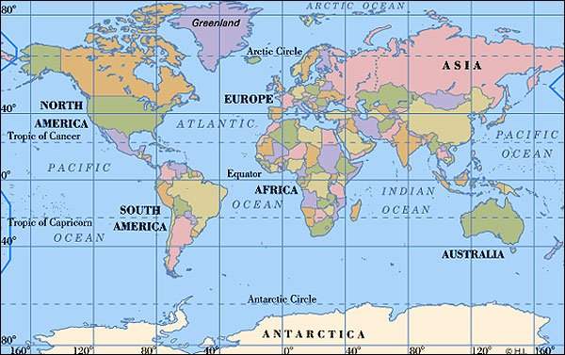
Concept - Purpose of the Declaration
The colonists wanted to justify to the world their decision to separate from England and create an independent country.
They wanted to prove they had good reasons for making their decision.
Why would the colonists care if the world agreed with their decision to leave England?
  Partner B share with Partner A “The colonists cared if the world agree with them because ____________.
  Partner A share with Partner B “I agree/disagree the colonists cared because __________. I also think they cared because __________.”
Notes:
7

Slide 8
Concept - What principles and philosophies are in the Declaration of Independence?
All men are created equal.
Unalienable rights - rights given by God that cannot be taken away.
Governments only exist if the people agree.
People can revolt if the government takes away their rights.
The United Colonies are free and independent states.
3. Which of the principles of the Declaration was the most important for the colonists?
  Partner A share with Partner B “The most important principle is ___________________ because __________________.
  Partner B share with Partner A “ I agree/disagree the most important principle is ________________ because __________. I also think _________________ is an important principle because ________________”
Notes:
8

Slide 9
Concept - How is the Declaration Organized
The Declaration of Independence is divided into four parts.
Preamble/Introduction
  Like most formal documents, the Declaration of Independence started with a preamble. A preamble acts as an introduction to the document, explaining the purpose.
Declaration of Natural Rights
  The second part focused on the notion of natural rights. Natural rights are rights that are guaranteed to people at birth.
Grievances
  The third part of the Declaration of Independence focused on how England and King George III had ruled the colonists oppressively, or unfairly.
Resolution
  The final part of the Declaration of Independence formally declared the colonies independent from England by announcing that the colonies were the United States of America.

Slide 10
Closure
Who was given the task of writing the Declaration of Independence?
Why did the colonists decide to write the Declaration of Independence?

